Slide 1
Artificial intelligence IV
Maria Markosova

Slide 2
Last lecture
Basic probability theory concepts, repetition.
Point and interval estimate
Monte Carlo simulations – principle, examples
MC sampling – direct and Metropolis sampling.
Metropolis sampling – mathematical arguments for sampling from the uniform distribution.
Rejection sampling

Slide 3
Outline
Minimax, alpha beta pruning in games – short recapitulation.
Monte Carlo tree search.
Probability theory in AI II - Bayesian nets and Bayesian inference.
Chain rule and Bayes net rule.
Examples of Bayesian networks.
What represents Bayesian network and how it models the real probabilistic domain.

Slide 4
Rejection sampling
We have a game with outcomes V1, V2 … Vn. Creator of the game gives us probabilities of each outcome. We want to train a game agent to guess these probabilities. Therefore we need a lot of training data. Therefore we need to simulate a game results from the known distribution, which is very complex. To generate the results from this distribution is difficult.
P(v)
Difficult sampling from this distribution.
V1
V2
V3
V4
V5 ...

Slide 5
How to sample?
Find a distribution from which to sample is easy. For example the uniform distribution. Give each result the same probability.
Enclose a complex distribution into a rectangular area.
For each result draw a line.
With a help of random generator generate points with coordinates (v,y).
Accept only the points under the curve . Reject other points.
P(v)
V1
V2
V3
V4
V5 ...

Slide 6
Minimax and Monte Carlo tree search
Minimax: Zero sum game of the two optimaly playing players. The game is started by the player Max, the player called Min answers. We are able to evaluate finishing positions of the players from the Max point of view. Usually implemented as alpha – beta pruning. Can be generalized to n players.
Example: tic - tac – toe (piskvorky)
MC tree search- MC method used to solve the two player game.

Slide 7
In each game, the player tries to maximize his gain and to minimize opponents gain. In Minimax the players play one by one , not simultaneously, and the algorithm works, because each player takes for granted, that the opponent is a rational agent, who wants to maximize his gain.
Max
Min
Tic tac toe
9 possibilities
…
…

Slide 8
Examples of possible final states of tic tac toe
Max win +1
Min win -1
Nobody wins 0

Slide 9
One move zero sum game MINMAX
0
MAX
MIN
MAX
0
-1
-1
0 1 -1 0 0 -1
(0,0) (1,-1) (-1,1) (0,0) (0,0) (-1,1)
Because it is a zero sum game (final results sum to zero), one can look on the final results as on a vector (-1,1). First value is a Max gain, the second Min gain. Both players try to maximize their gain.

Slide 10
Final values as a vectors.
(2, -2)
MAX
MIN
MAX
(-2, 2)
(-1, 1)
(2, -2)
(3,-3) (-2 ,2) (-1 ,1) (4 ,-4) (2,-2) (5 ,-5)
We can have a game, which has different evaluation of final states, but is still zero sum.

Slide 11
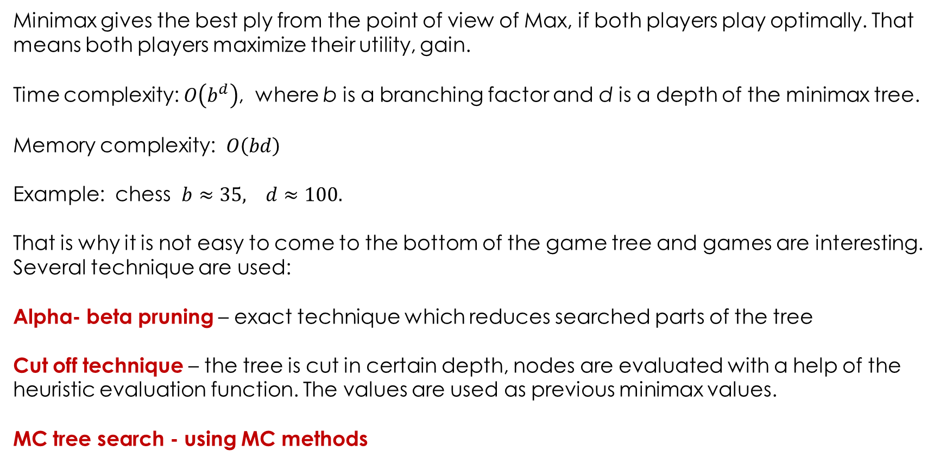
Minimax properties
Minimax gives the best ply from the point of view of Max, if both players play optimally. That means both players maximize their utility, gain.
Time complexity: $O\left(b^{d}\right)$, where b is a branching factor and d is a depth of the minimax tree.
Memory complexity: $O\left(bd\right)$
Example: chess $b≈35, d≈100.$
That is why it is not easy to come to the bottom of the game tree and games are interesting. Several technique are used:
Alpha- beta pruning – exact technique which reduces searched parts of the tree
Cut off technique – the tree is cut in certain depth, nodes are evaluated with a help of the heuristic evaluation function. The values are used as previous minimax values.
MC tree search - using MC methods

Slide 12
Alfa beta prunning
Classical MINIMAX
3
MAX
MIN
MAX
3
2
1
6 8 3 1 9 2 4 2 7

Slide 13
Alpha – beta pruning returns the same plies as Minimax, but does not search the whole tree.
MAX
MIN
MAX
3
2
1
6 8 3 1 9 2 4 2 7

Slide 14
Comment
Part of the tree should be searched as in depth first search. If you look at the situation at the middle branches, Max finds he can gain one. It is not necessary to search further, because if there is a better value for Max there, Min will never go there. If there is a better value for MIN there, Max won’t choose it, because he has a better option.

Slide 15
Game tree for more players:
(6,-5,-1)
(-4,-2,6)
(-4,-2,6)
(6,-5,-1)
(6,-5,-1)
(-4,-2,6)
(-3,-4,7)
(-4,-2,6)
(3,-8,5)
(-4,-2,6) (-5,6,-1) (-3,-4,7) (3,2,-5) (-4,-2,6) (3,-8,5) (6,-5,-1) (2,5,-7)

Slide 16
Comment
Whatever is the number of players, each of them wants to maximize his gain. So when the player in question is at ply, he looks at his gain (his position in the vector) and chooses the best possibility. First player looks at the first vector position, second at the second one etc.

Slide 17
Preliminary summary
Two player game
Minimax and Alpha beta prunning
More player games.

Slide 18
Monte Carlo Tree Search
Minimax and alfa beta pruning need to know the evaluation function giving the values of the final game states. Or at least we need to know how to estimate these values.
MCTS does not need to evaluate the final game states. Algorithm is based upon random search in a game space and the previous results of this search are used to build up the game tree successively
MCTS is applicable if:
1. Game results (final state values) are in certain boundaries from – to.
2. We have a complete information about the game rules.
3. Game duration is limited,

Slide 19
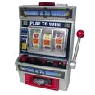
Illustration of the problem (multiarmed bandit problem example / problém mnohorukého hráča)
Problem: We have a lot of winning machines. If one pulls the arm, he wins or loose. We need to find arm-pulling strategy (sequence of pulls, actions) such that the expected total reward at time n is close to the best possible (one pull per time step)
Optimal (in expectation) is to pull optimal arm n times
Uniform Bandit is poor choice --- waste time on bad arms
Must balance exploring machines to find good payoffs and
exploiting current knowledge
start
a₁
a₂
a_{k}
…

Slide 20
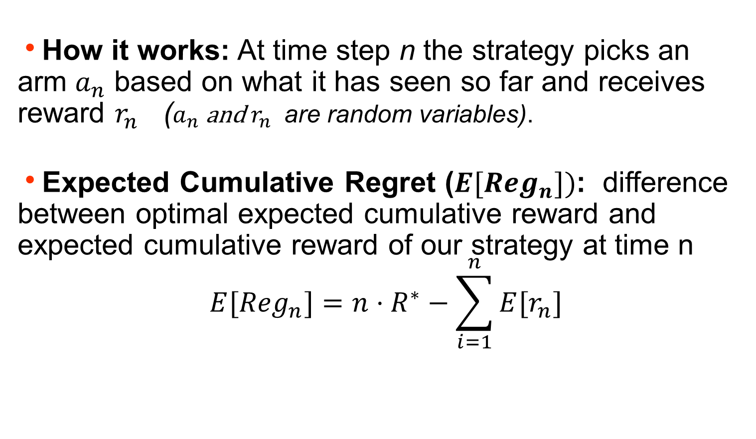
How it works: At time step n the strategy picks an arm $a_{n}$ based on what it has seen so far and receives reward $r_{n}$ ($a_{n} \text{and} r_{n}$ are random variables).
Expected Cumulative Regret (${E[Reg}_{n}])$: difference between optimal expected cumulative reward and expected cumulative reward of our strategy at time n
$${E[Reg}_{n}]=n⋅R^{∗}−\sum_{i=1}^{n}{{E[r}_{n}]}$$
R* - average reward given by optimal strategy
We need to find a strategy that minimizes this cumulative regret.

Slide 21
Algorithm for Minimizing Cumulative Regret
Auer, P., Cesa-Bianchi, N., & Fischer, P. (2002). Finite-time analysis of the multiarmed bandit problem. Machine learning, 47(2), 235-256.
Q(a) : average reward for trying action a (in our single state s) so far
n(a) : number of pulls of arm a so far
Action choice after n pulls:
Each time step n the arm of that machine is pulled which gives the maximum value of UCB.
:
c
Upper Confidence Bound
Value Term: favors actions that looked good historically
Exploration Term: actions get an exploration bonus that grows with ln(n)
constant

Slide 22
MCTS
https://www.youtube.com/watch?v=UXW2yZndl7U
Differently from the MINIMAX, MCTS builds a statistical game tree, which is only a part of the real game tree.
On the basis of this tree only the most promising nodes are searched, but leaving simultaneously some space to randomness and chance for the other nodes.
If there are two players value of the nodes is defined similarly to the Minimax. But it is gained by sampling, simulating the game.
Steps in the game tree creation: selection, expansion, simulation, backpropagation

Slide 23
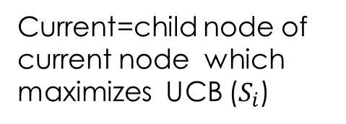


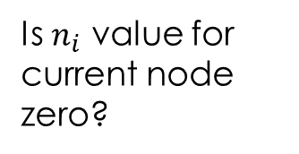
MCTS algorithm – tree traversal and node expansion (John Levin)
start
Rollout simulation
Root node $→$
Current node=$S_{0}$
yes
Rollout simulation
Is current node a leaf
yes
Is $n_{i}$ value for current node zero?
Current = first new child node
no
no
Current=child node of current node which maximizes UCB ($S_{i}$)
For each available action from current add a new state to the tree

Slide 24

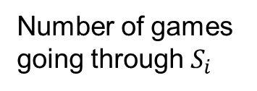


UCB (upper confidence bound) strategy?
Selection step : In this step we balance our knowledge about the game gained up to now by the simulation, and the searching the unknown promising parts of the tree. We want to do the best possible draws, sometimes probing the worse draws. Selection includes all depths of the tree.
Upper confidence bound for tree strategy (UCB): Let I is a set of nodes which can be reached from the actual node p. We select a successor of p, which fulfills the condition
C is fitted experimentally, often C=2 is taken.
Number of games going through the parent of i
$$S_{i}$$
$$S_{i}$$
Number of games going through $S_{i}$
Average value of
$$S_{i}$$

Slide 25









MCTS example
$$S_{i}$$
$n_{0}$=0
$$S_{0}$$
$$a_{1}$$
$$a_{2}$$
$$S_{1}$$
$$S_{2}$$
Initial state
$$n_{1}=0$$
$$n_{2}=0$$
For both nodes and zero n_{i} we set k to infinity.

Slide 26

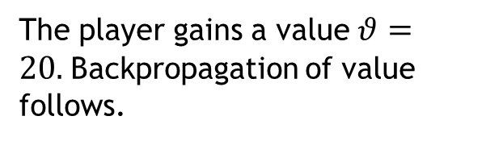


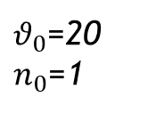

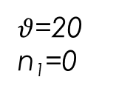




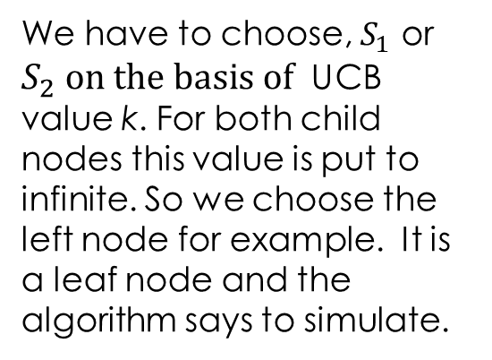
$$S_{i}$$
$θ_{0}$=20
$n_{0}$=1
$n_{0}$=0
$$S_{0}$$
C=2
$$a_{1}$$
$$a_{2}$$
$$S_{1}$$
$$S_{2}$$
We have to choose, $S_{1}$ or $S_{2} on the basis of$ UCB value k. For both child nodes this value is put to infinite. So we choose the left node for example. It is a leaf node and the algorithm says to simulate.
$θ$=20
n₁=0
n₂=0
n=0
Random moves to the end of the game
$θ$=20
The player gains a value $θ=20.$Backpropagation of value follows.

Slide 27


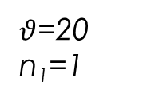
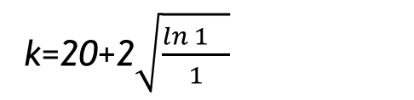
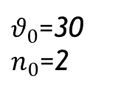
Situation after the first iteration of the algorithm.
$$S_{i}$$
$θ_{0}$=20
$n_{0}$=1
C=2
$θ_{0}$=30
$n_{0}$=2
$n_{0}$=0
$$S_{0}$$
$$a_{1}$$
$$a_{2}$$
$$S_{1}$$
$$S_{2}$$
$θ$=20
n₁=1
n=0
n=0
n₂=1
$θ$=10
k=20+2$\sqrt{\frac{\ln{1_{}}}{1}}$
k=infinity
Random moves to the end of the game
Backpropagation of the value
$θ$=10

Slide 28
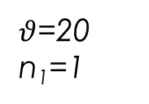
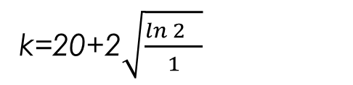


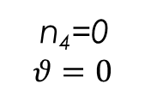
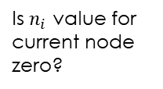

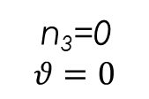
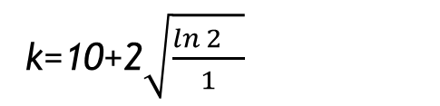
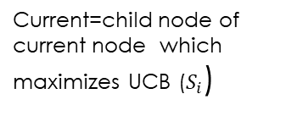


Situation after the second iteration of the algorithm.
$$S_{i}$$
$θ_{0}$=20
$n_{0}$=1
C=2
$θ_{0}$=30
$n_{0}$=2
$n_{0}$=0
$$S_{0}$$
Maximizes UPC value k
$$a_{1}$$
$$a_{2}$$
start
Rollout
simulation
$$S_{1}$$
$$S_{2}$$
$θ$=20
n₁=1
Current node=$S_{0}$
n=0
yes
n=0
n₂=1
$θ$=10
$$a_{3}$$
$$a_{4}$$
Rollout simulation
k=10+2$\sqrt{\frac{\ln{2_{}}}{1}}$
Is current node a leaf
yes
Is $n_{i}$ value for
current node
zero?
$$S_{3}$$
$$S_{4}$$
Current = first new child node
n₃=0
$$θ=0$$
n₄=0
$$θ=0$$
no
no
k=20+2$\sqrt{\frac{\ln{2_{}}}{1}}$
Current=child node of current node which maximizes UCB ($S_{i}$)
For each available action from current add a new state to the tree

Slide 29
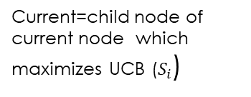


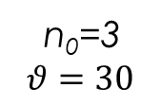
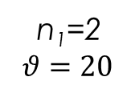
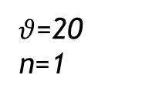
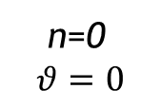
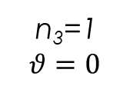
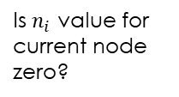
$$S_{i}$$
$θ_{0}$=20
$n_{0}$=1
C=2
$θ_{0}$=30
$n_{0}$=2
$n_{0}$=0
n₀=3
$$θ=30$$
$$S_{0}$$
Maximizes UPC value k
$$a_{1}$$
$$a_{2}$$
start
Rollout
simulation
$$S_{1}$$
$$S_{2}$$
Current node=$S_{0}$
yes
$θ$=20
n=1
Rollout simulation
n₁=2
$$θ=20$$
n=0
n=0
n₂=1
$θ$=10
$$a_{3}$$
$$a_{4}$$
Is current node a leaf
yes
Is $n_{i}$ value for
current node
zero?
Current = first new child node
$$S_{3}$$
$$S_{4}$$
no
no
n₃=1
$$θ=0$$
n₄=0
$$θ=0$$
n=0
$$θ=0$$
Current=child node of current node which maximizes UCB ($S_{i}$)
For each available action from current add a new state to the tree
$$θ=0$$
Value backpropagation

Slide 30

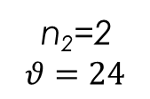
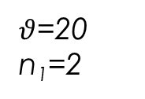
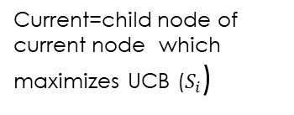
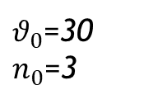

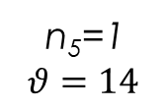



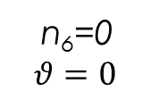
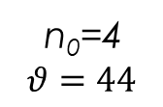
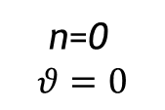
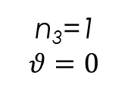


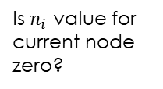
Situation after the third iteration of the algorithm.
$$S_{i}$$
n₀=4
$$θ=44$$
C=2
$θ_{0}$=20
$n_{0}$=1
$θ_{0}$=30
$n_{0}$=3
$n_{0}$=0
$$S_{0}$$
$$a_{1}$$
$$a_{2}$$
start
Rollout
simulation
k=11.48
$$S_{1}$$
$$S_{2}$$
Current node=$S_{0}$
k=12.10
yes
$θ$=20
n₁=2
n=0
Rollout simulation
n=1
$θ$=10
$$a_{3}$$
$$a_{4}$$
n₂=2
$$θ=24$$
n₁=0
$$a_{5}$$
$$a_{6}$$
Is current node a leaf
yes
Is $n_{i}$ value for
current node
zero?
$$S_{3}$$
$$S_{4}$$
$$S_{5}$$
$$S_{6}$$
Current = first new child node
n₄=0
$$θ=0$$
n=0
$$θ=0$$
no
no
n₃=1
$$θ=0$$
n₅=1
$$θ=14$$
n₆=0
$$θ=0$$
Current=child node of current node which maximizes UCB ($S_{i}$)
For each available action from current add a new state to the tree
$$θ=14$$
Value backpropagation

Slide 31

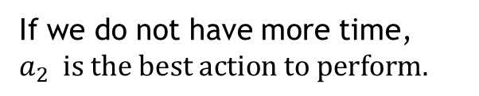
Situation after the forth iteration of the algorithm.
$$S_{i}$$
n₀=4
$$θ=44$$
C=2
$θ_{0}$=20
$n_{0}$=1
$θ_{0}$=30
$n_{0}$=3
$n_{0}$=0
$$S_{0}$$
$$a_{1}$$
$$a_{2}$$
$$S_{1}$$
$$S_{2}$$
$θ$=20
n₁=2
n=0
If we do not have more time, $a_{2} is the best action to perform.$
n=1
$θ$=10
n1=0
n₂=2
$$θ=24$$
$$a_{3}$$
$$a_{4}$$
$$a_{5}$$
$$a_{6}$$
To continue, build the tree according the algorithm, starting at the root and recalculating k-s, performing rollouts or adding a new nodes.
If we have one player game (bandit problem) next moves maximize values. If we have a two player game, take values as the Minimax values.
$$S_{3}$$
$$S_{4}$$
$$S_{5}$$
$$S_{6}$$
n₃=1
$$θ=0$$
n₄=0
$$θ=0$$
n=0
$$θ=0$$
n₅=1
$$θ=14$$
n₆=0
$$θ=0$$

Slide 32
Preliminary summary
Repetition of minimax, alpha beta pruning, for two and more players
Multibandit problem
Monte Carlo tree search

Slide 33
Probability theory in Artificial intelligence II
Chain rule for the full joint probability calculation
Independency, conditional independency – basic relations
Bayesian network – example
Bayes net rule and chain rule.
Bayesian network as a model of the probabilistic domain.

Slide 34
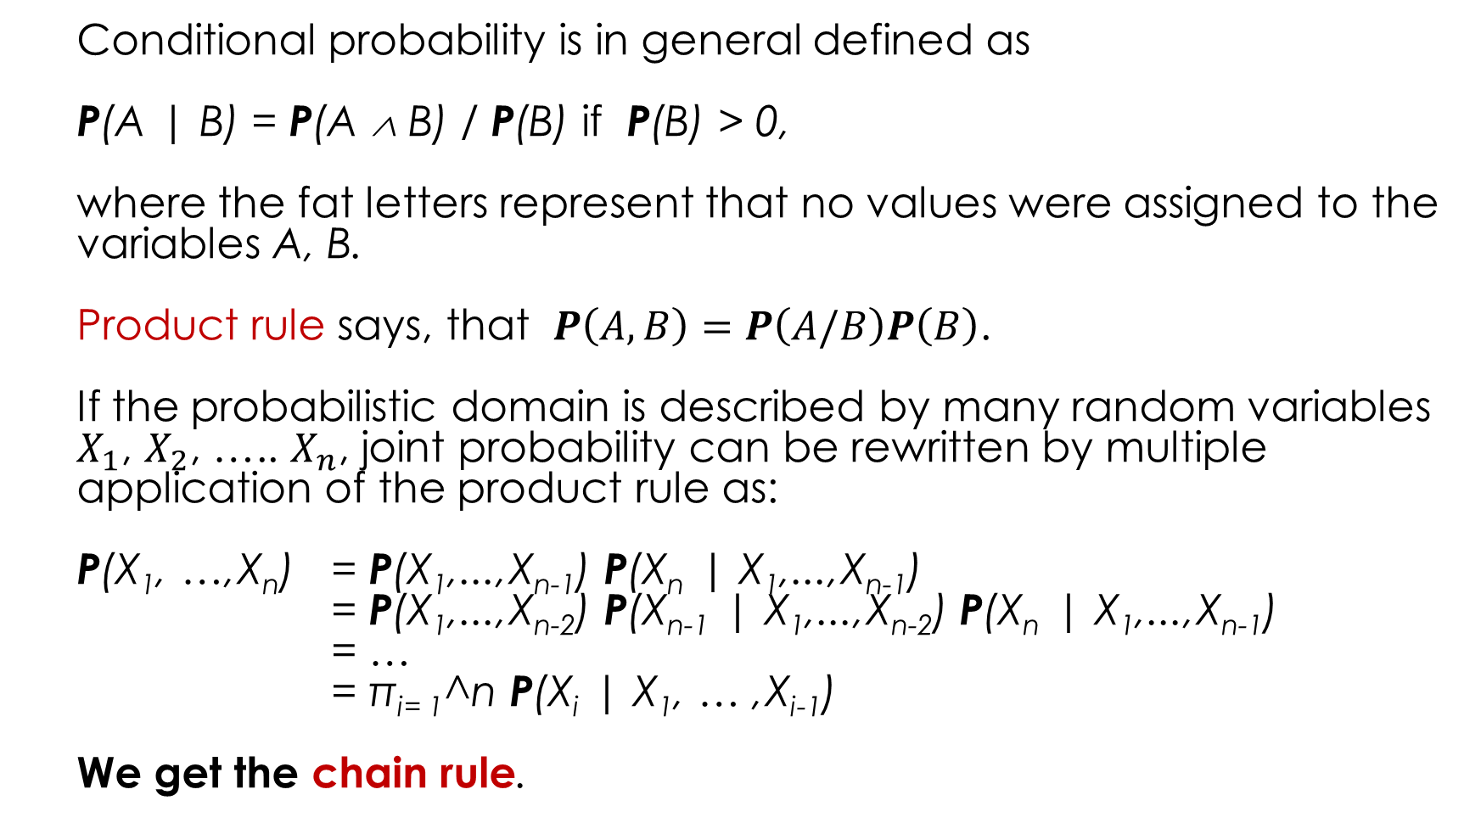
Chain rule
Conditional probability is in general defined as
P(A | B) = P(A ∧ B) / P(B) if P(B) > 0,
where the fat letters represent that no values were assigned to the variables A, B.
Product rule says, that $P\left(A,B\right)=P\left(A/B\right)P\left(B\right)$.
If the probabilistic domain is described by many random variables $X_{1}$, $X_{2}$, ….. $X_{n}$, joint probability can be rewritten by multiple application of the product rule as:
P(X₁, …,X_{n}) = P(X₁,...,X_{n-1}) P(X_{n} | X₁,...,X_{n-1})
= P(X₁,...,X_{n-2}) P(X_{n-1} | X₁,...,X_{n-2}) P(X_{n} | X₁,...,X_{n-1})
= …
= π_{i= 1}^n P(X_{i} | X₁, … ,X_{i-1})
We get the chain rule.
P(A,B) is the same as P(A^B)

Slide 35
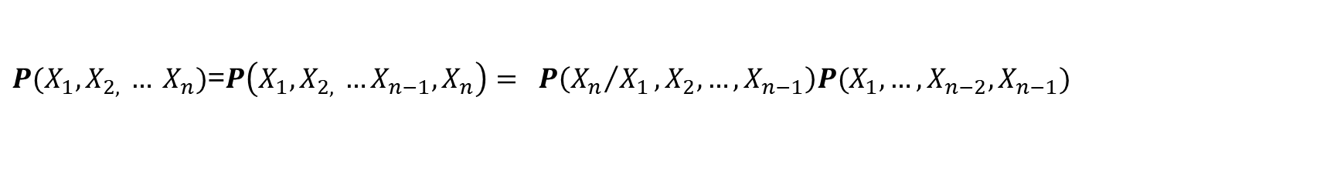
Derivation of chain rule:
$P(X_{1},X_{2, }… X_{n})$=$P\left(X_{1},X_{2, }…X_{n−1},X_{n}\right)= P\left({X_{n}}/{X_{1}},X_{2}, …, X_{n−1}\right)P(X_{1},…,X_{n−2}, X_{n−1})$
B
A
A’
B’
Apply product rule
Apply product rule
Product rule is applied subsequently until we get the final formula, chain rule.

Slide 36
Cancer testing example
Cancer example. Let C is a binary (Boolean) random variable , there are two possibilities, the person has a cancer or has no cancer. P(C=t=c)=0.01. Let us have another binary random variable test (T). Test can be positive or negative T=+=t, T=-= רt. There are some conditional probabilities we know:
What is the probability P(c/+)?
Rewrite by the product rule
0.9 x 0.01
0.9 x 0.01
0.2 x 0.99
Rewrite by the product rule

Slide 37
Basic Bayesian network
In the cancer example we have two Boolean random variables C and T . C has a value a . T has a value + a – (or t and ¬ t ).
C is an obsetrvable random variable, T is a measurable random variable . The fact, that a person has a cancer influences the test result.
C
P(C)
P(T/C)
T
How to calculate P(C,T)?
Chain rule for this case?
The same

Slide 38
More complex Bayesian network
P(C)
C
We make two independent tests.
P(T1/C)
How the chain rule for this case looks like?
P(T2/C)
T1
T2
We utilize the fact, that the tests are independent
Chain rule in which we incorporate the relations of the conditional independency is called Bayes net rule. All variables are Boolean.
The real world situation is usually not that ideal. One can imagine, that after the test T1 there are residuals of some chemical which influences the result of T2. Conditional independency is thus violated, which in reality often is.
B. network is thus a MODEL of the real situation.

Slide 39
P(C)
How would you calculate ?
Let us know that:
C
P(T1/C)
P(T2/C)
T1
T2
P(+,+)=P(+,+,c)+P(+,+,¬c)
Využili sme vzťahy podmienenej nezávislosti. We utilized the relations holding for the conditional independency

Slide 40
Another more complex Bayesian network
Whether I am feeling happy (H) is influenced whether it is sunny (S) or whether I have a free time (FT). All random variables are Boolean.
S
FT
H
Chain rule for this case?

Slide 41
S
FT
H
How to rewrite the chain rule utilizing independencies as given on the picture? We believe that S and FT are independent.
We used the fact, that S and FT are independent – whether there is a sun is independent from the fact I have a free time (not necessarily in reality, because I am more prone to have a free time if the weather forecast is good).
Calculate P(ft/h) at home .

Slide 42
Comment
Whenever you are told to utilize the fact that some variables are conditionally independent , you are asked to utilize the formulas for the conditional independency and incorporate them into a chain rule.

Slide 43
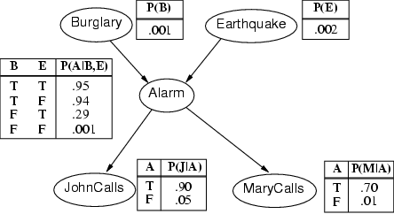
Even more complex Bayesian network.

Slide 44
Russel and Norwig example of Bayesian network describes the following situation.
I'm at work, neighbor John calls to say my alarm is ringing, but neighbor Mary doesn't call. Sometimes it's set off by minor earthquakes. Is there a burglar?
Variables: Burglary (Vlámanie), Earthquake (Zemetrasenie), Alarm, JohnCalls (Johnov telefonát), MaryCalls (Máriin telefonát)
Network topology reflects "causal" knowledge:
A burglar can set the alarm on
An earthquake can set the alarm on
The alarm can cause Mary to call
The alarm can cause John to call

Slide 45
What Bayesian network represents?
Two views:
It represents full joint probability of the probabilistic domain in question.
It codes the relations of independency and conditional independency.

Slide 46
Comment
I told several times, that whenever we know full joint probability distribution in a probabilistic domain (e.g. we know the probability of each atomic event), we know all about the domain. But this is often not the case. Therefore, to estimate the full joint probability distribution, we use a MODEL of the domain, represented by a Bayesian network. In a model we omit some dependencies (as in the cancer examples), in order to be able to do the calculations in a simpler way.

Slide 47
P(bulgl)=0.001
P(earthq)=0.002
Bulglary
Earthquake
P(Alarm/Bulg, Earthq)
Alarm
P(JC/Alarm)
P(MC/Alarm)
MaryCalls
JohnCalls

Slide 48
Full and shortened table for the Boolean random variables
T | T | 0.95 | 0.05
T | F | 0.94 | 0.06
F | T | 0.29 | 0.71
F | F | 0.001 | 0.999
In the shortened version only the table in the red frame is used.
Generalization for the discrete random variables; the full table has so many columns as is the number of the discrete variable values.

Slide 50
Bayesian network and the full joint probability representation / Bayes net rule
A
P(A)
P(B/A)
B
P(C)
C
P(T1/C)
P
P(T2/C)
T1
T2
P(S)
P(FT)
S
FT
P(H/S,FT)
H

Slide 51
Bulglary
Earthquake
P(A,B,EA,MC,JC) =P(B)P(EA)P(A/B,EA)P(MC/A)P(JC/A)
Alarm
MaryCalls
JohnCalls

Slide 52

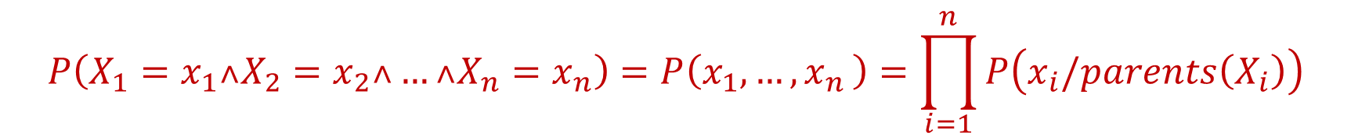
Generalization:
In all Bayesian networks Bayes net rule holds:
$$P\left(X_{1}=x_{1}˄X_{2}=x_{2}˄…˄X_{n}=x_{n}\right)=P\left(x_{1},{…,x}_{n}\right)=\prod_{i=1}^{n}{P\left(x_{i}/parents\left(X_{i}\right)\right)}$$
Specific value of Parents($X_{i}$)
How to construct such Bayesian network, that the Bayes net rule is good enough? Remember, Bayesian network is a MODEL of a real situation.

Slide 53
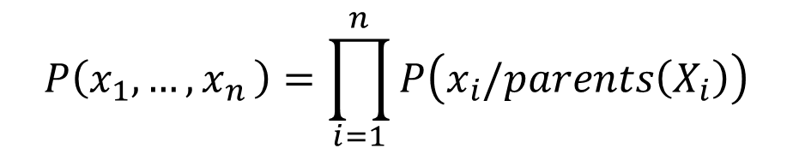
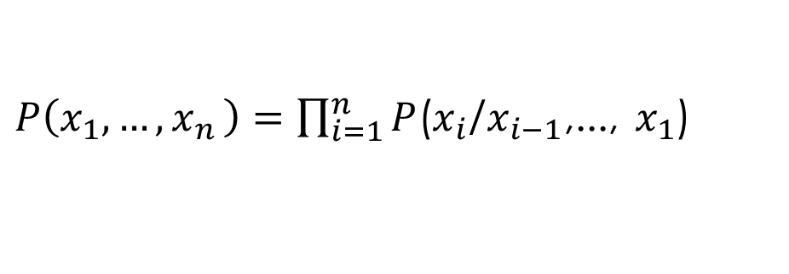
$$P\left(x_{1},{…,x}_{n}\right)=\prod_{i=1}^{n}{P\left(x_{i}/parents\left(X_{i}\right)\right)}$$
Let us compare b. net rule:
and the exact chain rule:
Bayesian network is a good domain representation if and only if every node is conditionally independent on its predecessors except of the parents.
$P\left(x_{1},{…,x}_{n}\right)=\prod_{i=1}^{n}{P}$($x_{i}$/$x_{i−1}$,..., $x_{1}$)
Bulg.
Equa.
Alarm
M.Calls
J.Calls

Slide 54
Summary
Monte Carlo tree search
Bayesian networks introduction / chain rule, Bayes net rule

